Slide 1
Web Marketing and Communication Management
A project by:
Emanuela Elli (892901)
Federica Madon (825628)
Tommaso Strada (829351)

Slide 2
Business questions
1) Customer relationship valorization:
How do we increase the relationship profits?
Which are the customer base features? How can it be divided?
Which are the most valuable customers?
Who are the likely churners? What is the reason for this?
2) Products valorization:
Which are the most purchased items?
Which are the valuable items combinations?

Slide 3
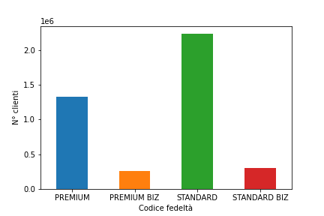
CUSTOMER EXPLORATION
31%
6%
PREMIUM
PREMIUM_BIZ
55%
8%
STANDARD
STANDARD_BIZ
Customers fidelity class count

Slide 4
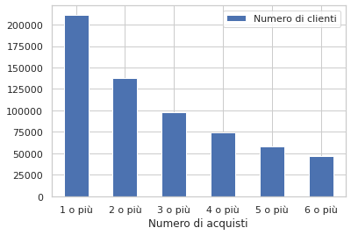
CUSTOMER EXPLORATION
The top 3 customer for purchasing items are:
Customer distribution for number of purchases
376925
177 purchase
117212
155 purchase
248975
154 purchase

Slide 5
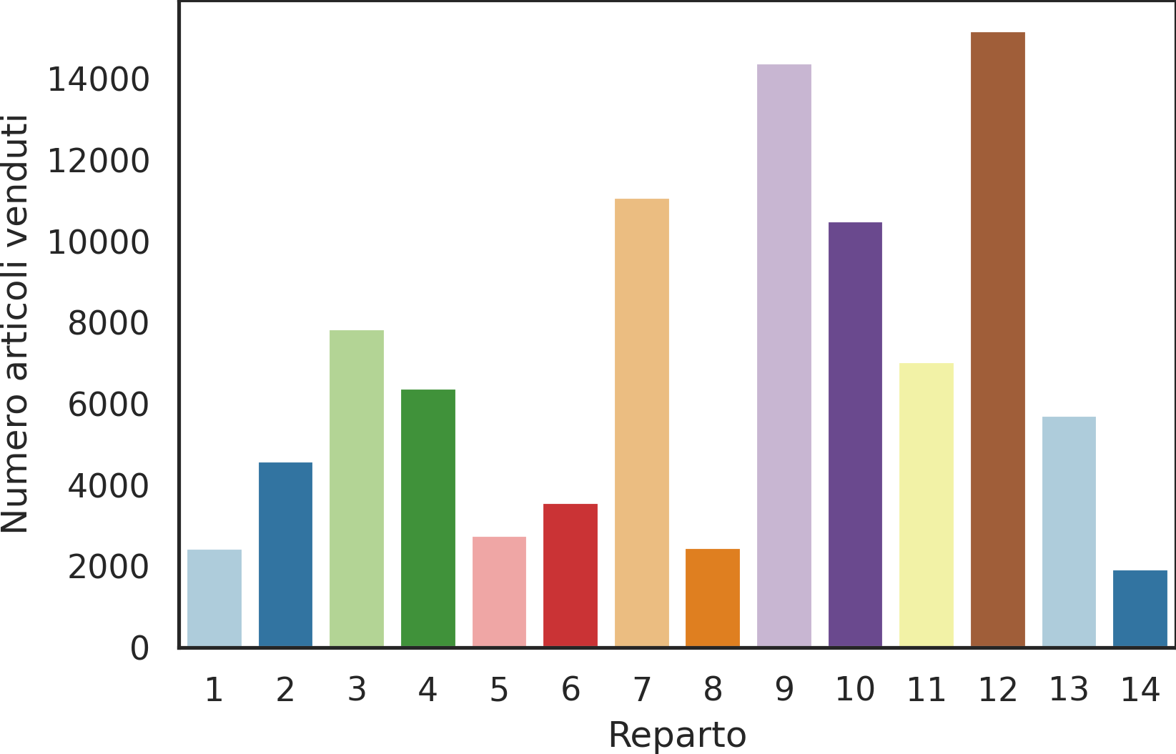
PRODUCTS EXPLORATION
After the data preparation step, there are:
902994 different bills
95826 different items sold among 14 departments
Product distribution for departments
The most sold items belong to the 12 department

Slide 6
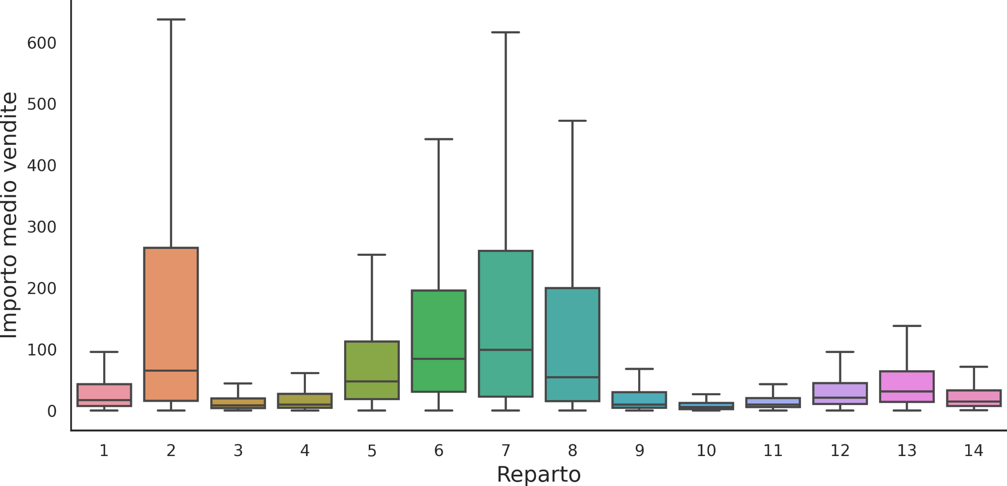
PRODUCTS EXPLORATION
Average sales amount for departments
The department 7 items have the highest median of items sold.

Slide 7





DATA DRIVEN-STRATEGY
Business questions
Models
Actions data driven
Data cleaning
Evaluation

Slide 8
DATA PREPARATION
Duplicates
Returns
Normalization
Net amount
The rows with the same item id but different amounts are removed.
The rows concerning a return are removed
IMPORTO_NETTO variable is built. The rows with negative values are removed
Normalization to the correct format (es: DATE = DATETIME).

Slide 9
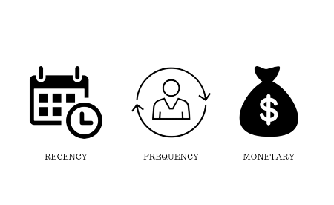

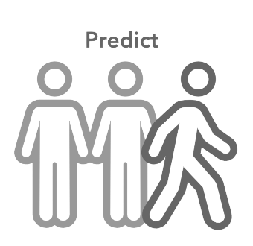
MODELS
MARKET
BASKET
ANALYSIS
RFM
CHURN
PROPENSITY
Dividing customers based on their value to plan different marketing and communication strategies
Studying products affinity to increase sales
Product valorization
Customer valorization
Preventing churners increasing fidelity and retention

Slide 10
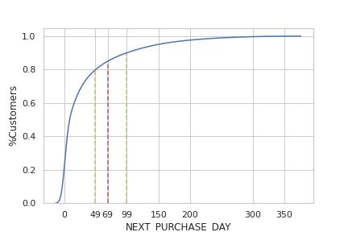
RFM PREPARATION
Next Purchase
Day Curve
85% of users buy within 69 days
Preprocessing
Customers splitting into active and inactive. The cut point is fixed on 2019-02-19. It is equal to 69 days before the last available date.
Measure building: Recency, Frequency, Monetary Value
Building RF Matrix e RFM Matrix.

Slide 11
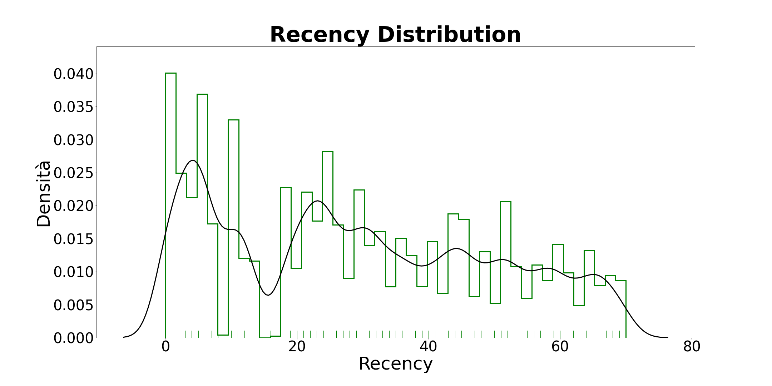
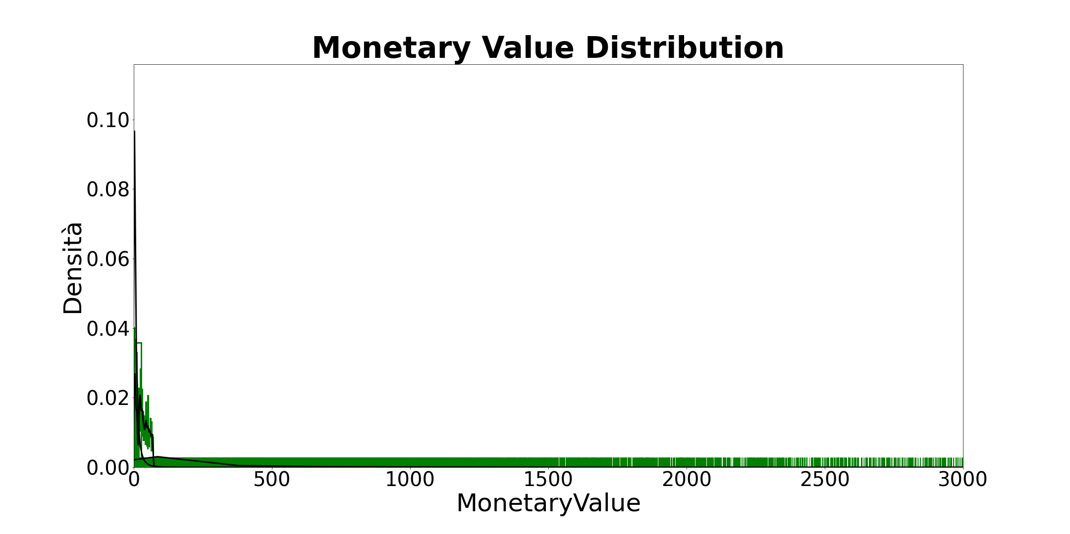
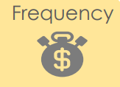
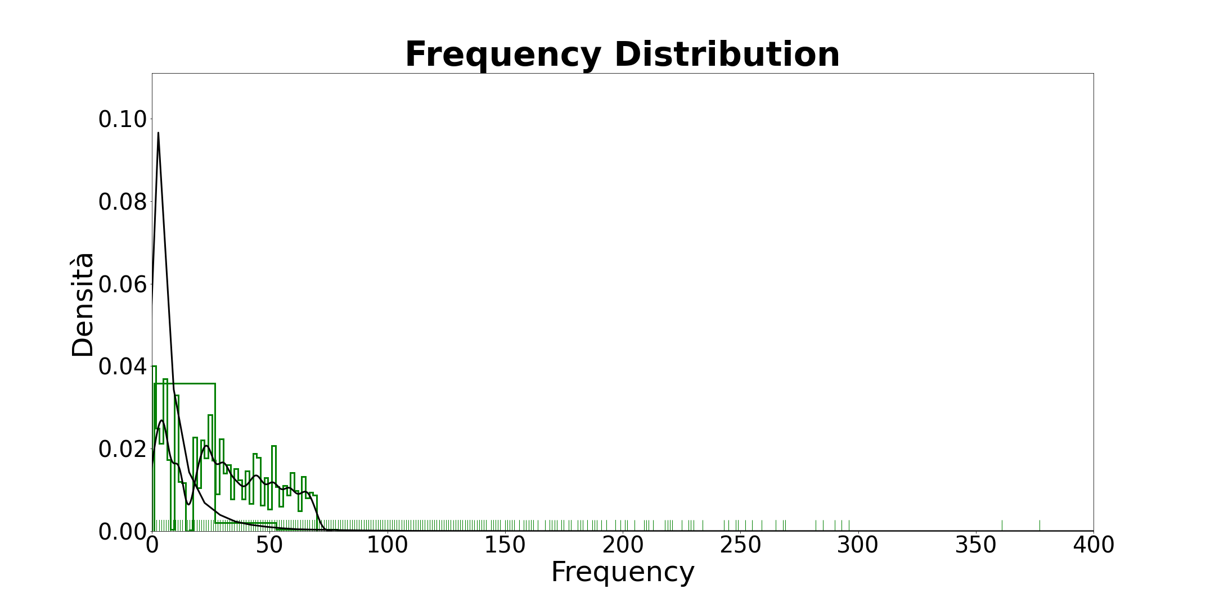
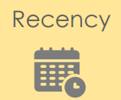
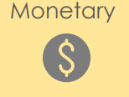
RFM
Distributions
Time passed by since the last purchase or interaction with the item.
Total transactions
Total or average value of transactions

Slide 12
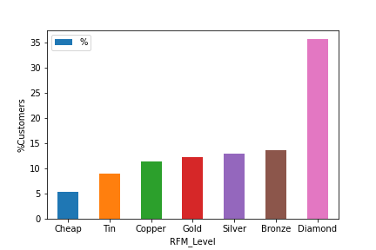
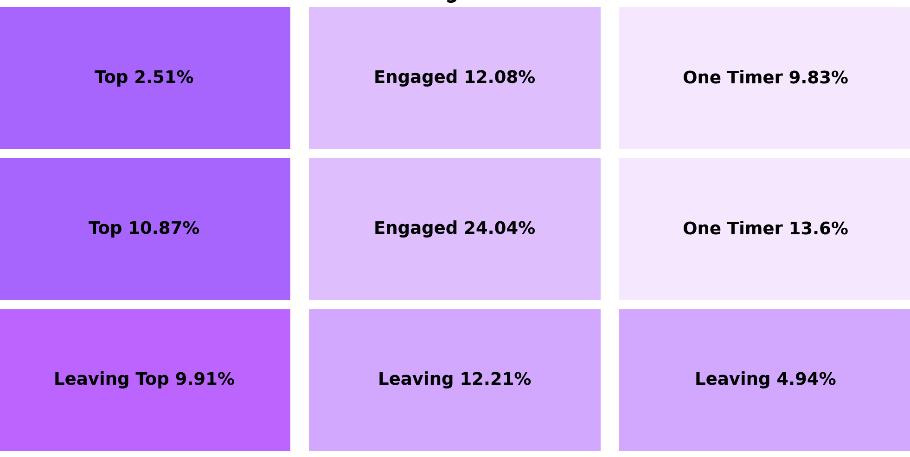
RFM
RF Matrix
RF Matrix
Engaged(36.12%): Customers who recently buy with frequency on average.
Diamond(35.56%): Customers with high Monetary value and Top RF
FREQUENCY
Low
R
E
C
E
N
C
Y
Medium
High
High
Medium
Low

Slide 13
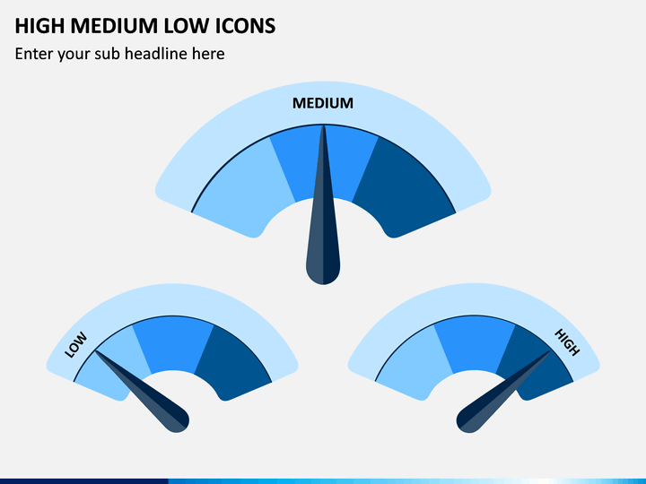
HIGHER VALUE CUSTOMERS
MEDIUM VALUE CUSTOMERS
LOWER VALUE CUSTOMERS
RFM INSIGHTS
Keeping this kind of customer, giving valuable items.
Recommending other products and suggesting fidelity programs.
Engaging this type of customer and increasing the retention

Slide 14
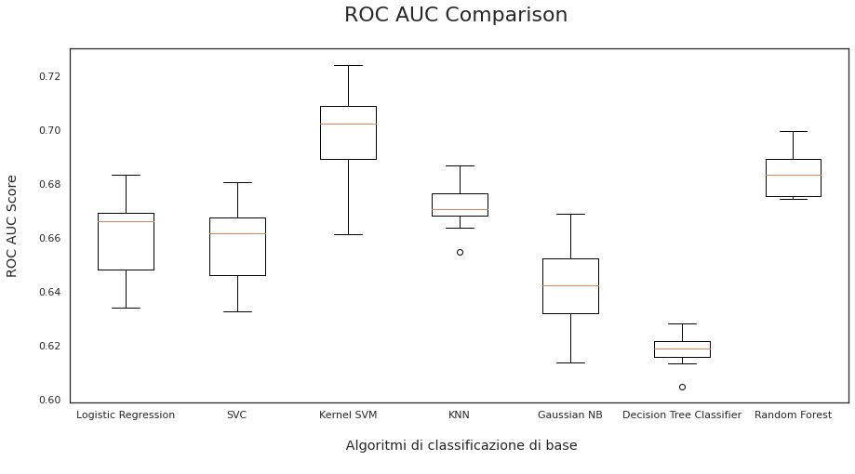
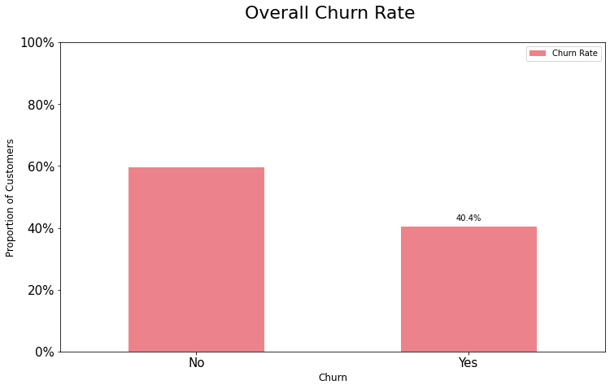
CHURN PROPENSITY
Si è scelta come data di riferimento 19/02/2019 pertanto:
Features considerate
Algoritmi utilizzati
Type fidelity program
Main account
Active account
First and last date activation
Reference store
Number of subscriptions for each client
email account provider
phone number added
type client account
client job
Logistic regression
SVC
Kernel SVM
KNN
Gaussian NB
Decision Tree Classifier
Random Forest
Lookback period 1/05/2018 - 19/02/2019
Holdout period 19/02/2019 - 20/04/2019

Slide 15
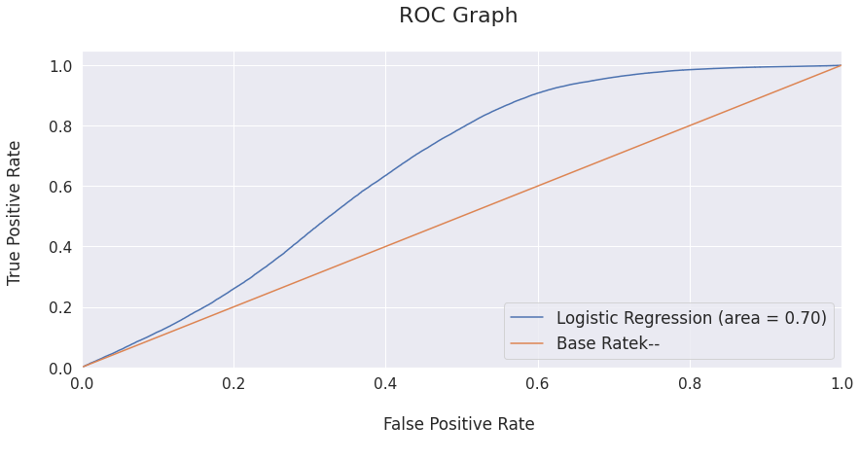
CHURN PROPENSITY
The logistic regression is an optimal model since it has the highest relative combination of precision, recall e F1 score.
The model is evaluated by ROC curve. It shows the model’s capacity to distinguish the classes using the AUC average score.
The orange line shows the ROC curve of a random classifier (a good classifier stays far from this line).
As the figure shows, the optimized logistic regression gets a higher AUC score than the random model.

Slide 16
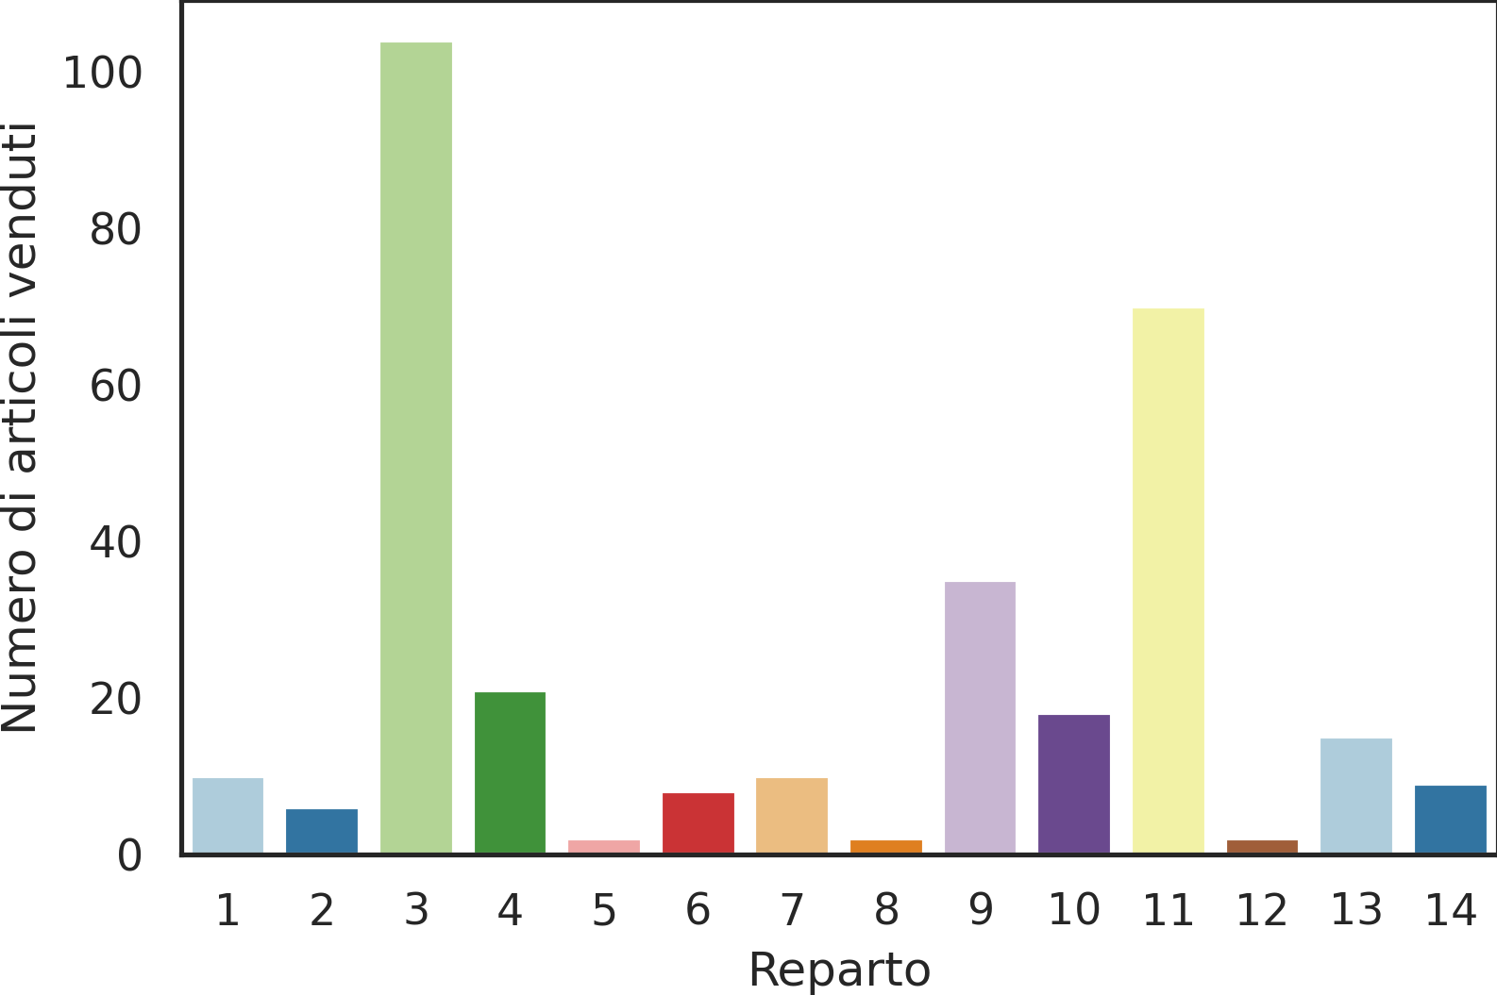
MARKET BASKET ANALYSIS
188938 different bills- 62582 different products
Only items with support level higher than 0.1% are selected
Overview of high support articles
There are 312 items with a high support level
DateTime starts from 19/02/2019 for being coherent with the other models

Slide 17
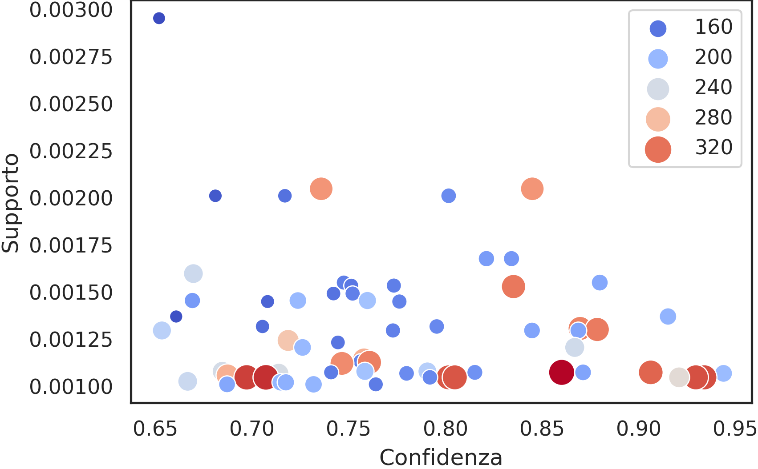
MARKET BASKET ANALYSIS
Apriori Algorithm
Association Rules
Pruning rules
390 interesting itemsets with support > 0.1% belong to the third department
Association rules
Lift
66 relevant associations
with confidence > 0.65 and lift > 1
Associazioni interessanti
36298353→36298381
36298381→36298353

Slide 18
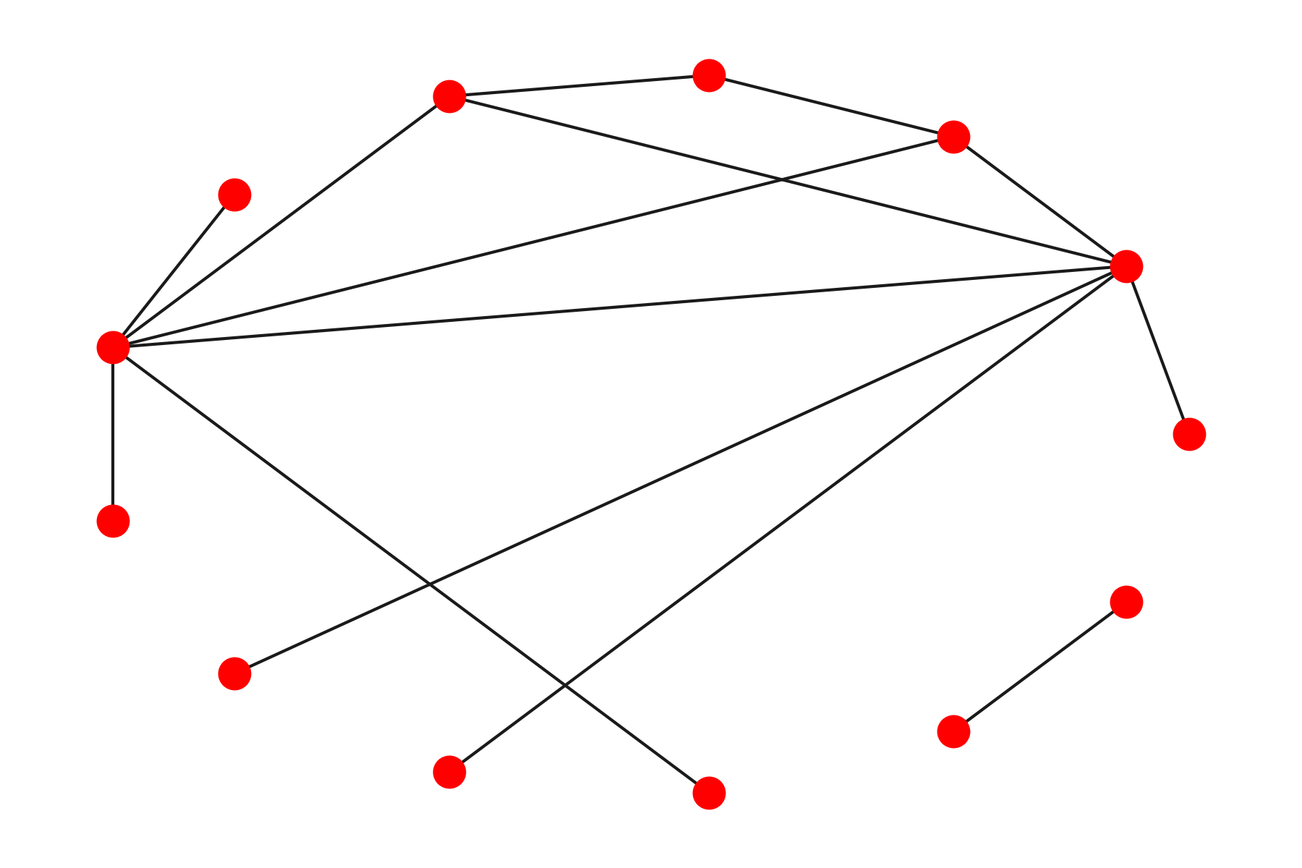
MARKET BASKET ANALYSIS
Items 36298353 and 36298381 are the most “driven” products.
Item 36298353 is the most popular among the items with the highest support.
The association(36298353, 36298122) → 36298381 is the one with the highest lift (> 354)
The customers following the rule with the highest lift, buy the three products every 17 days on average
Top 15 association rules
36298416
36298353, 36298381
36298395, 36298381
36298395
36298381
36298353
36298353, 36298122
36298416, 36298381
36298122
36298353, 36298395
36298206
36298416, 36298353
36298122, 36298381

Slide 19

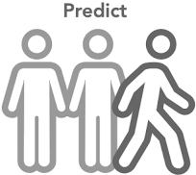
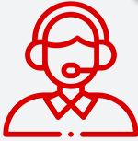
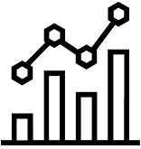
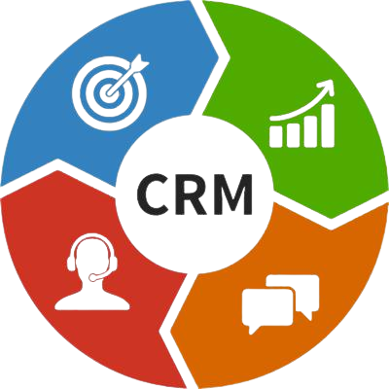


DATA DRIVEN ACTIONS
Move Silver and Bronze customers to Gold level
Following the Gold level, the majority of customers are divided into Silver and Bronze levels. It is convenient to engage this type of customer, increasing loyalty and developing up/cross-selling actions (creating personalized promotional item bundles in both physical and online stores). Some possible strategies include customizable email campaigns, sales offer based on customer habits, developing a strong relationship with customers beginning with the onboarding process, and offering rewards.
Churners prediction and caring action
Keeping potential churner costs less than acquiring a new one. Indeed, it is critical to plan and implements caring actions in order to avoid losing them. Some specific actions include: providing special offers, rationalizing and diversifying the contact marketing strategy based on churner risk, and so on..
Insight integration in the marketing automation
To supplement the contact strategy with the 'next best product to buy' based on the relationship between the leading and pulling categories.
CRM
Customer relationship management to boost loyalty, advocacy, and sales opportunities
Promotions
Promotions can be defined by calculating the average latency for certain product associations.
Layout optimization
Optimize product allocation by dividing items into leading and pull categories.

Slide 20
Thanks for your time!

